Slide 1
Sessions
Managing state information

Slide 2


Conversational State
A servlet on its own has no mechanism for associating consecutive requests from the same client
In order to implement servlet for things like shopping carts we need a way of sharing data between the requests of a client
add item to basket
item added
checkout

Slide 3
Conversational State
Another example is an installation wizard such as the one in OpenMRS 1.5+
We need to remember the answers for each page...
Page 1
Page 2
Page 3
Page 3
Install!

Slide 4
Session Objects
To share data between client requests, we use the HttpSession object, which has these members:
setAttribute(String name, Object value) - stores a named value
getAttribute(String name) - retrieves the named value
We can store anything in a session object, though it is not recommended to store large amount of data

Slide 5
Session Objects
add iPod to shopping basket
setAttribute()
Servlet A
Client A
Container
Session A
Thread A
client sends request to
container to add iPod
to basket
servlet adds iPod item to session
associated with this client,
as an attribute

Slide 6
Session Objects
item added
Servlet A
Client A
Container
Session A
Thread A
servlet returns a response to the client
to confirm that the iPod was added to their
shopping basket

Slide 7
Same Client, Same Session
checkout
Different request, so different thread
getAttribute()
Servlet A
Client A
Container
Session A
Thread B
client requests to purchase the
items in their shopping basket
servlet gets the iPod item
from the session associated
with this client

Slide 8

Different Client, Different Session
add XBox to shopping basket
setAttribute()
Servlet A
Client B
Container
Session B
Thread C
client sends request to
container to add XBox
to basket
servlet adds XBox item to session
associated with this client,
as an attribute

Slide 9
Who Owns Which Session?
HTTP is a stateless protocol so every request appears to come from a new client
IP addresses aren't necessarily unique, so they can't be used
Instead, when a client makes their first request, the server generates a unique session ID, and sends this back to the client
When the client makes another request, they identify themselves using the session ID

Slide 10
First Request, New Session ID
add iPod to shopping basket
setAttribute()
Servlet A
Client A
Container
Session
ID: 6347
Thread A
client sends request to
container to add iPod
to basket
container creates new HttpSession
object with a unique session ID

Slide 11
Session ID Returned to Client
item added
Session ID: 6347
Servlet A
Client A
Container
Session ID: 6347
Thread A
container returns a response which includes
the new session ID

Slide 12
Session ID Now Sent By Client
checkout
Session ID: 6347
getAttribute()
Servlet A
Client A
Container
Session
ID: 6347
Thread B
client sends the session ID
as part of its request
container gets the session object
associated with this client
using the session ID

Slide 13
Sending Session IDs
The easiest way for the container and servlet to send and receive a session ID is using cookies
A cookie is a name/value pair, it can be:
Transmitted in an HTTP request or response
Stored on the clients computer

Slide 14
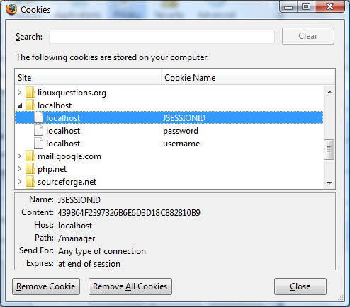

Cookies
Firefox allows us to view the cookies that are stored on our machine

Slide 15
The First Response
item added
Session ID: 6347
HTTP/1.1 200 OK
Set-Cookie: JSESSIONID=6347
Content-Type: text/html
Content-Length: 456
Connection: close
<html>
...
</html>

Slide 16
The Second Request
checkout
Session ID: 6347
POST /checkout.htm HTTP/1.1
Host: mysupercoolshop.com
User-Agent: Mozilla/5.0
Cookie: JSESSIONID=6347
Accept: text/xml,text/html

Slide 17
Custom Cookies
Cookies are not just for session IDs - they can store any small piece of data
We can create them as name/value pairs and add them to the server response...
Cookie cookie1 = new Cookie("username", "Bob");
Cookie cookie2 = new Cookie("password", "x23d2");
response.addCookie(cookie1);
response.addCookie(cookie2);

Slide 18
Custom Cookies
They can then be read from the client request
Unfortunately there is no method to get a named cookie, so we must search ourselves...
for (Cookie cookie : request.getCookies()) {
if (cookie.getName().equals("username")) {
username = cookie.getValue();
break;
}
}

Slide 19
Custom Cookies: Expiration
By default cookies will expire (i.e. be deleted) when the client closes their browser (at the end of their "session")
But we can specify a time in seconds for the cookie to be kept, so that next time the client opens their browser, it still exists...
Cookie cookie = new Cookie("username", "Bob");
cookie.setMaxAge(10000); // seconds
response.addCookie(cookie);

Slide 20
URL Rewriting
Sometimes cookies will not work
The user may have disabled them in their browser
In such a case the container will attempt to use URL rewriting instead
This means the session ID is appended to every link that the user might click, e.g.
/checkout.htm
/checkout.htm?jsessionid=6347

Slide 21
URL Rewriting: encodeURL
This requires every link in your site to be encoded using response.encodeURL()
out.println("<a href=\"/checkout.htm\">"
+ "Go to checkout</a>");
out.println("<a href=\""
+ response.encodeURL("/checkout.htm")
+ "\">Go to checkout</a>");

Slide 22
Getting The Session Object
The session object is accessed through the request object, i.e
HttpSession session = request.getSession();
If it is a client's first request, then getSession() will return a new session
Otherwise, it will return an existing session object
session.isNew() will tell us if it is a new session or an existing one

Slide 23


Managing Sessions
Many users means many session objects
Session
ID: 6347
Session
ID: 1357
Container
Session
ID: 8463
Session
ID: 9889

Slide 24

Expiring Sessions
Sessions objects use up memory so they should be deleted once a client has finished making requests
But there is no mechanism in HTTP for knowing when a client has finished
We can though tell the container to delete sessions after they haven't been used for a certain amount of time

Slide 25
Expiring Sessions
When we create a session we can call setMaxInactiveInterval() to tell the container how long to wait before deleting the session
Or we set the session timeout value in the DD
<web-app>
...
<session-config>
<session-timeout>15</session-timeout>
</session-config>
</web-app>
Tells the container to delete sessions once they haven't been accessed for 15 minutes

Slide 26
References
Books
Head First Servlets and JSP (O'Reilly)
Websites
http://java.sun.com/javaee/reference/tutorials/

